Slide 1
CS 260 Project: AI-powered Ad Creatives Generation and Campaign
By: Jaclyn, Nathan, Sudeeksha, Ruslan, Alicia

Slide 2
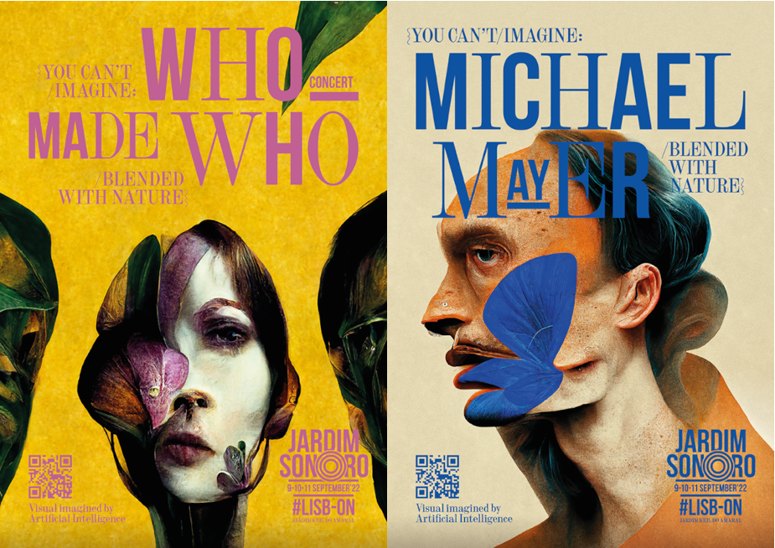
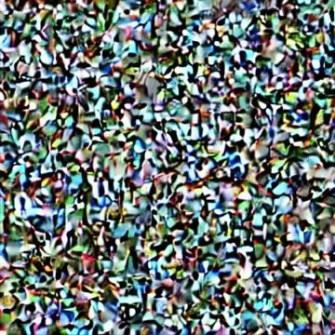
Finding the “Unpredictable”
AI-powered tools to help agencies brainstorm ideas while saving time and money
New horizons such as custom ads created for individuals or organizations
Abstract art-based Ad for DJ set (Dentsu Inc.)
AI-powered image generation
Notes:
Russ -
It’s no surprise that generating creatives for online ads has been a costly and inefficient process.
With recent milestones in AI world, agencies are shifting to DALL-E and other tools such as Midjourney and Stable Diffusion to create striking and sometimes unpredictable visuals from text descriptions with high image quality, speed, and low resource/memory requirements.
New horizons are now open to customize ads for events, create special effects for music festivals or nightclubs, or even making e-commerce advertising more efficient.

Slide 3


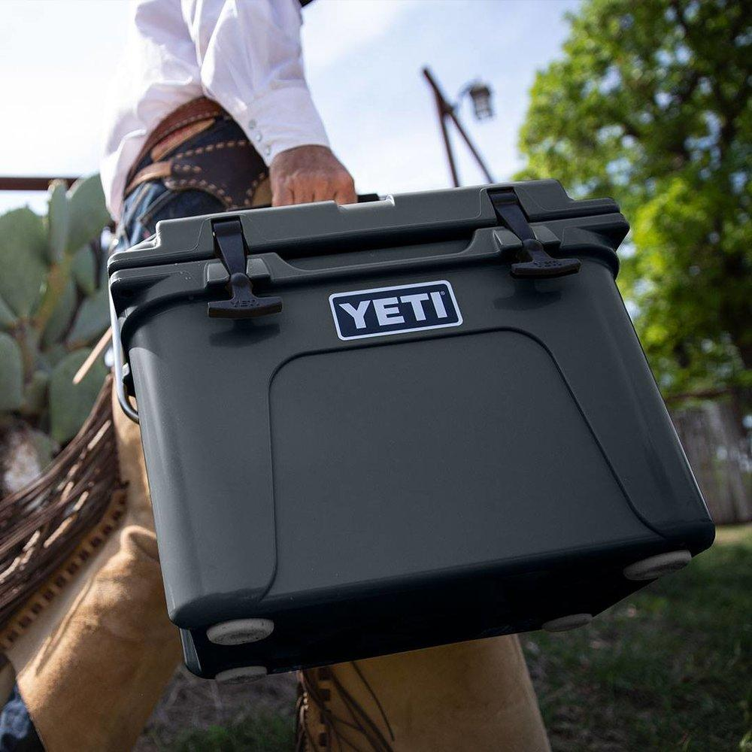
Generative Advertisements
A new wave for E-commerce world
Product imagery and assets completely unique to individual customers
Case study - Can we efficiently generate realistic yet unique YETI coolers Ads?
Use case example for generative Ads
YETI cooler Ad
Notes:
Russ -
This leads to an exciting future where AI-based technologies can create custom “generative” advertising that is tailored for individual person.
For our project, we decide to leverage this technological breakthrough to efficiently generate online ads for YETI cooler box with custom backgrounds and colors that could be in favor for different users, while retaining realistic imagery including its logo. We then conduct a survey to evaluate the model for further improvement and customization.

Slide 4
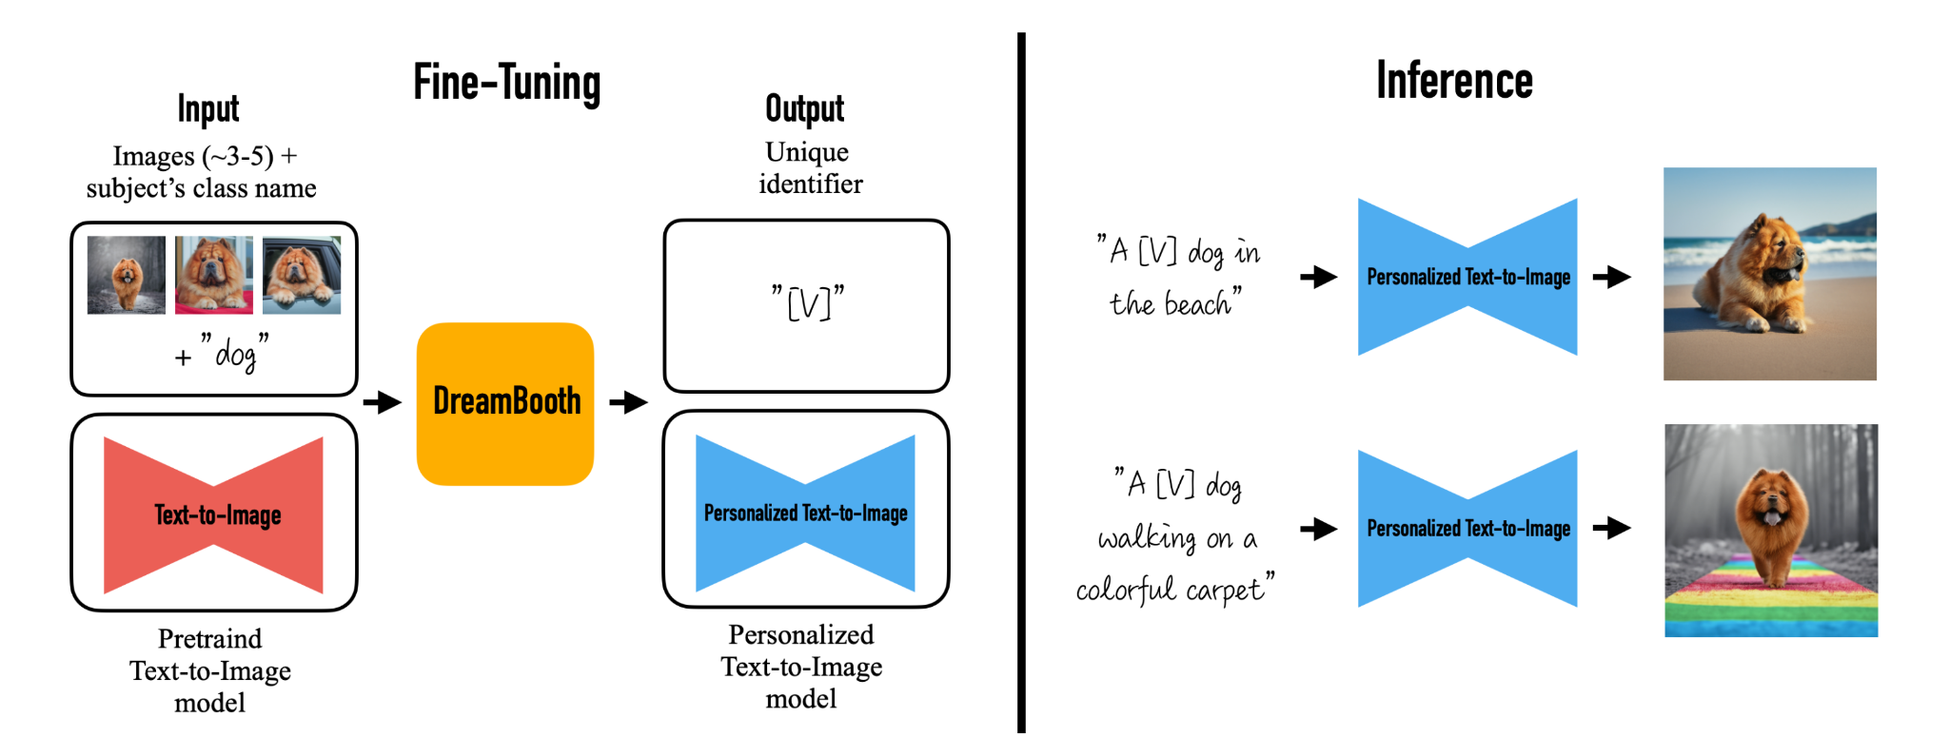
Model Selection
DreamBooth - diffusion-based text-to-image generation model
Utilizes stable diffusion 1.5 model
Notes:
Alicia

Slide 5
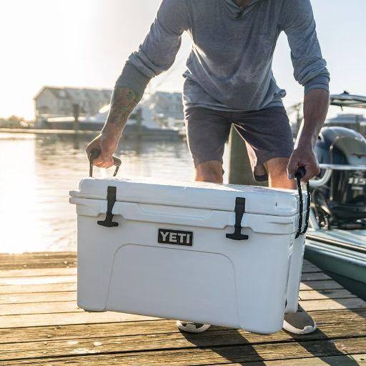
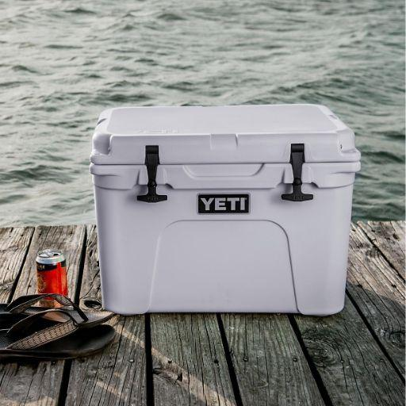
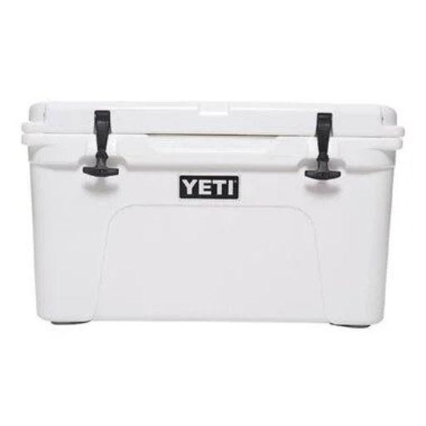
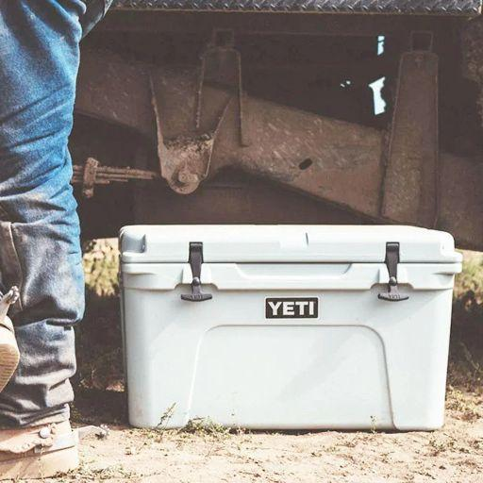
Training Model
Tuning Parameters:
Max training steps
Learning rate
# of training images
Variety of training images
Unique identifier:
“Photo of yeti cooler”
Sample training images
Notes:
Sudeeksha:
We did 6 experiments to train on variety of pictures like White yeti , yeti with human subjects as seen on slide with number of pictures between 5-10.
Dreambooth tends to overfit quickly. To get good-quality images, we must find a 'sweet spot' between the number of training steps and the learning rate. Varied LR 1e-6 to 3e-6 ,Training steps:800-1500.
Unique identifier was subject :Photo of yeti cooler across all variations that enabled class prior preservation to generate new poses and articulations of the subject in different contexts.

Slide 6
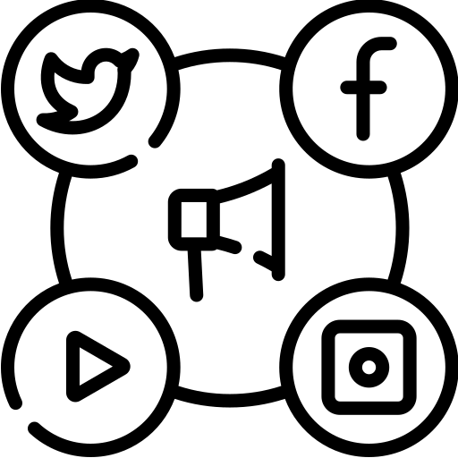
Model Evaluation
Measure output images by proxy version of their Click-Through Rate (CTR) used in the real world ad-delivery system
“How likely are you to click on this advertisement if you are interested in this product?”
Rate on a scale of 1-10
Conducted survey of output images of model and actual advertisements
total of 8 images per model ( 6 models)
total of 8 advertisements pulled from online
109 people surveyed
Notes:
Click-Through Rate = number of clicks that your ad receives/number of times your ad is shown
Nathan

Slide 7
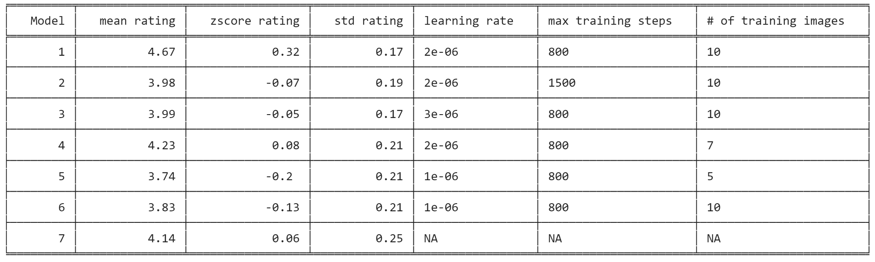
Results by Model
*model 7 are pictures of yeti coolers found online
Notes:
Jackie

Slide 8
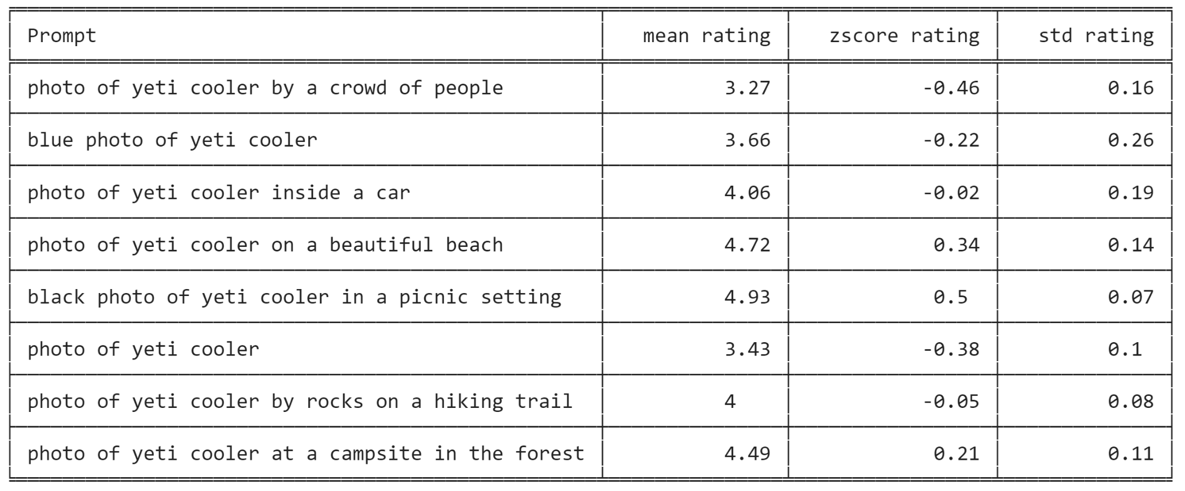
Results by Prompt
Notes:
Jackie

Slide 9
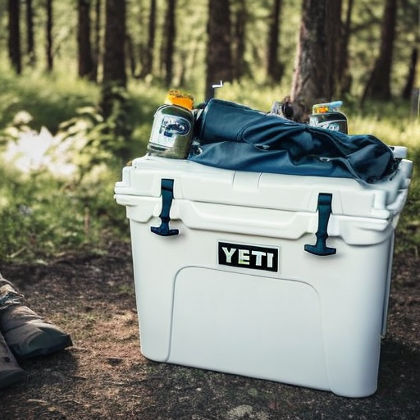
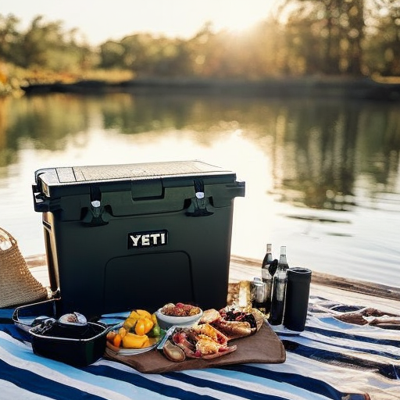
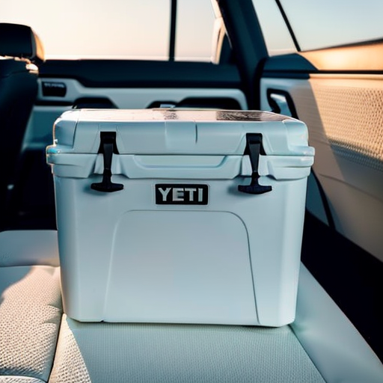
Sample Images from Model 1
“Photo of yeti cooler at a campsite in the forest”
“Black photo of yeti cooler in a picnic setting”
“Photo of yeti cooler
inside a car”
Notes:
Jackie

Slide 10
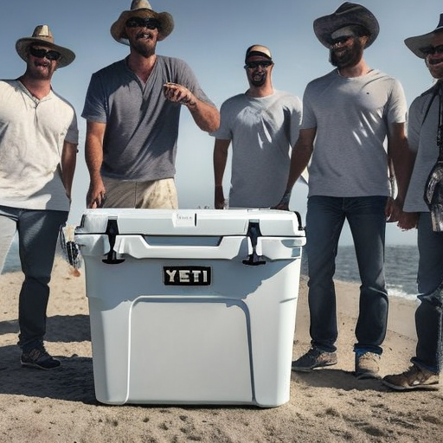
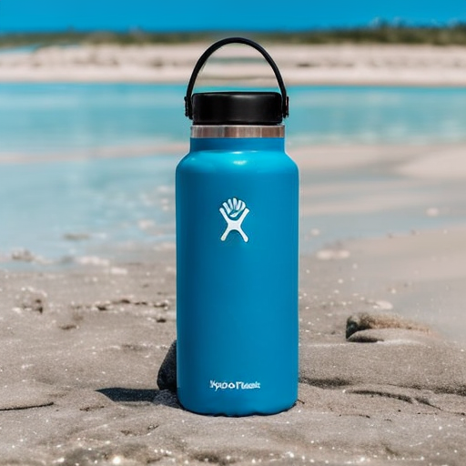
Conclusion/Further Improvements
Our model performs as well as actual images and ads online
Best model finds a balance in amount of training steps and learning rate
Works well in natural settings and environments
Further Improvements
Create pipeline for A/B testing to get CTR rates from online advertising
Improve model output for smaller legible texts and humans
Improve efficiency of model (training takes about 30 min per model)
Implementing AI generated advertisements has high potential in the future to increase efficiency within a company
Distorted faces
Hydroflask letters not clear
Notes:
Jackie
Model 1 performed the best out of all models and even better than images we found online
This model had parameters that gave a balance between training steps and learning rate to avoid overfitting and underfitting
Limitations of DreamBooth Model
In conclusion, using AI generated advertisements has high potential in the future to increase efficiency within a company, while the models may not be able to help all companies right now, it retains a high potential still in th next couple years

Slide 11
Thank You

